Slide 1

#protectyourself

Slide 2
WHO WE ARE
Wekume Mobile App is a cutting-edge solution designed to provide easy access to essential sexual and reproductive health services for university students and young adults
Wekume App is primarily designed for University students of all backgrounds, ensuring inclusivity and accessibility for everyone. It addresses the unique challenges and questions that students may have about sexual and reproductive health. It’s however tailored to suit other people who might have unique needs.

Slide 3
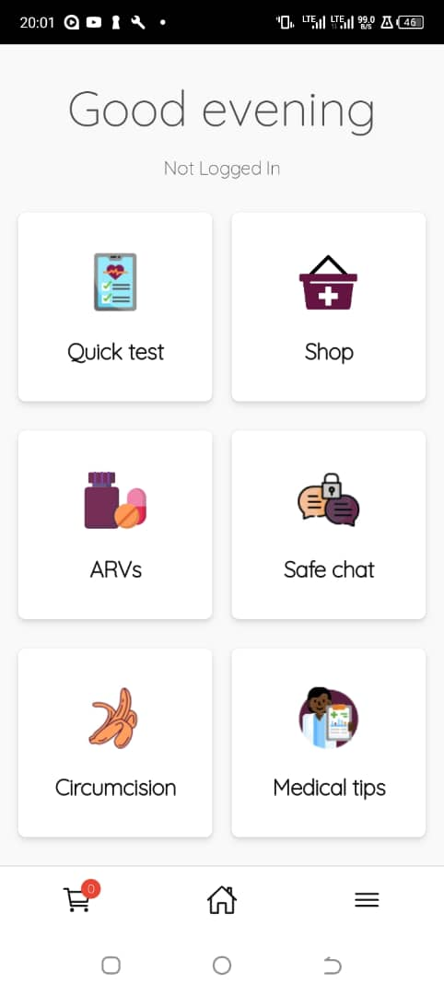
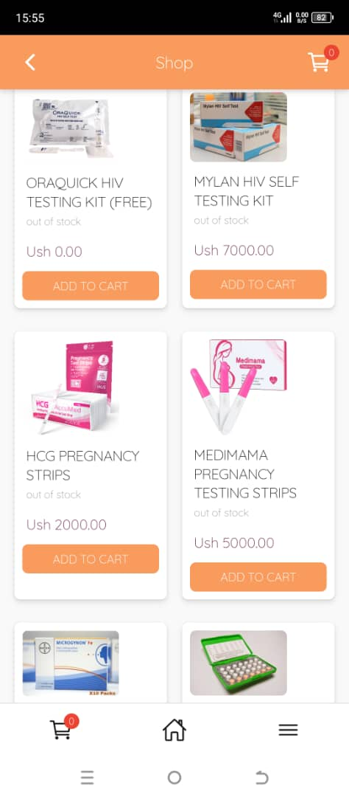
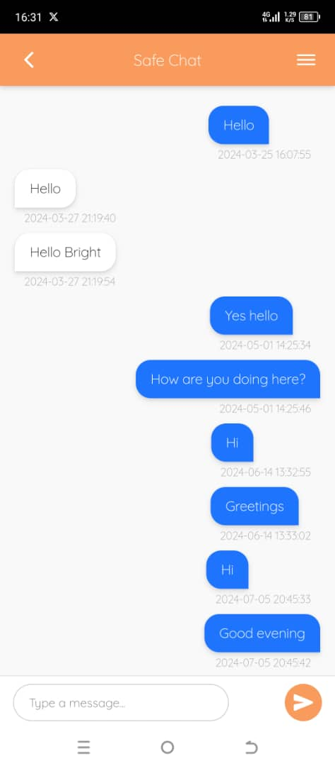
An outlay of the mobile App

Slide 4
How It Works;
Wekume simplifies access to vital information and services related to sexual and reproductive health:
Download the app for free from Playstore.
Create a personalized profile.
Start a journey of information, resources, and support tailored to students’ needs.
Observation:
SRH service accessibility: Fingertip access to confidential and affordable SRH services.
Proves to counterattack Stigma around SRH.
Privacy & Non discriminatory when seeking information.

Slide 5
Call to Action
We offer a special invitation to all interested stakeholders at different levels as we work to improve and provide better services in these sectors below;
Collaborators and partners
Improve Apps next version: Optimizing the user interface and expanding functionality.
Expand outreach and awareness.
Technical development
Debugging
App security and data privacy features
IOS version
USSD

Slide 6



Contact Us:
Social Media:
Tel
wekume
0784049640
0701117234
wekume
0753777984
info@wekume.com
wekumeinfo@gmail.com

Slide 7
THANK YOU FOR YOUR TIME

